Slide 1

An Presentation on TIC TAC TOE Presented by: Rishi Khadka Karan Kumar Gupta Migeen Lamichhane
BIT First Semester 2022

Slide 2
Content
Introduction
Features
Objective
Algorithm
Flowchart
Gantt Chart
Conclusion
Reference
Appendices

Slide 3
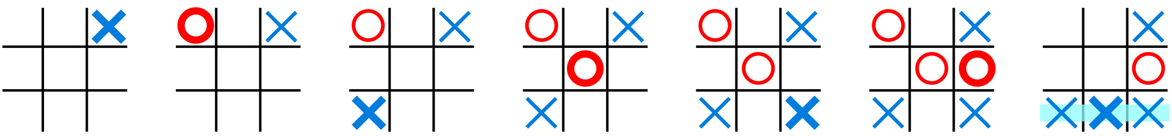
Introduction
Tic-tac-toe is a paper and pencil game for two players, X and O.
Player who places three of their mark first in a diagonal, horizontal or vertical way will be the winner.
Fig:

Slide 4
Feature
Login.
Multi player (player vs player).
Computer mode (player vs computer).
Best of Three(player vs player).
Help/how to play.
Show score

Slide 5
Objective
To entertainment purpose.
To have a good times with friends.

Slide 6
Algorithm
Step1: Start
Step2: Display cover page
Step3: Display login method
Step4: If user name and password match with the existence credentials goto step5
Otherwise goto step 3
Step5: Display main menu:
5.1 How to play
5.2 Player vs Player
5.3 Computer vs Player
5.4 Best of three (Player vs Player)
5.5 Exit

Slide 7
Step6: Read option from the user
Step7: If how to play goto step8
Step8: Display how the game works.
Step9: Display how to play game and goto step 5
Step10: If player vs player
Step11: Display the player choice x or o
Step12: If player choice whether x or o the goto step 13
Step13: Display game board
Step14: Display win goto step 15 16
Step15: Display x win goto step5
Step16: Display o win goto step5
Step17: If computer vs player then goto step 18

Slide 8
Step18: Display the player
Step19: If x or o then goto step 20
Step20: Display game board
Step21: If computer win then goto step 22
Step22: Display computer win and goto step 5
Step23: If player win goto step 24
Step24: Display player win and goto step 5
Step25: If best of three goto step26
Step26: Display choose player1 or player2
Step27: If player1 or player2 then goto step 28
Step28: Display game board
Step29: If player1 or player2 win then increase 1 point

Slide 9
Step 30: Display game board
Step31: If player1 or player2 win increase 1 point
Step32: If player1 or player2 have higher point goto step 33
Step33: Display the player1 win and goto step 5
Step34: Display the player2 win goto step5
Step35: If 5 exit
Step36:stop

Slide 10
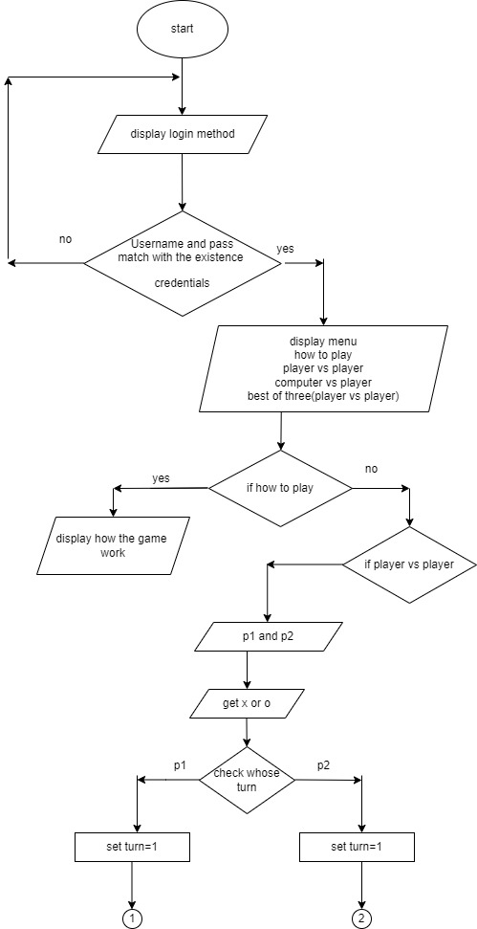
Flowchart

Slide 11
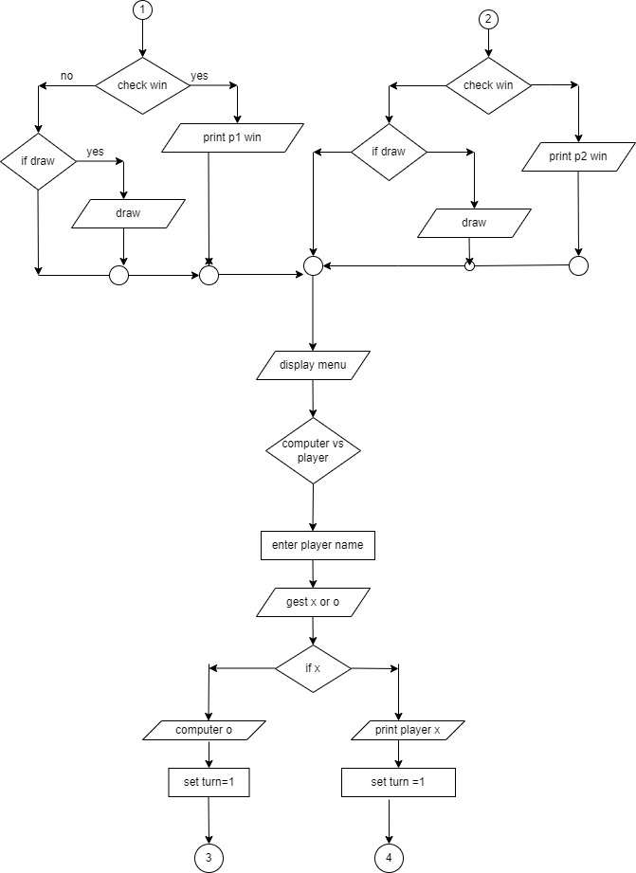

Slide 12
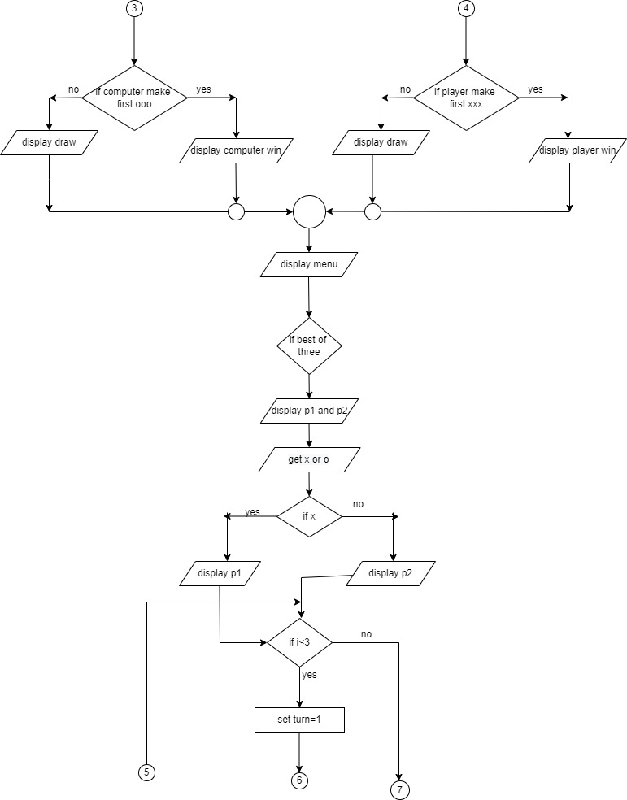

Slide 13
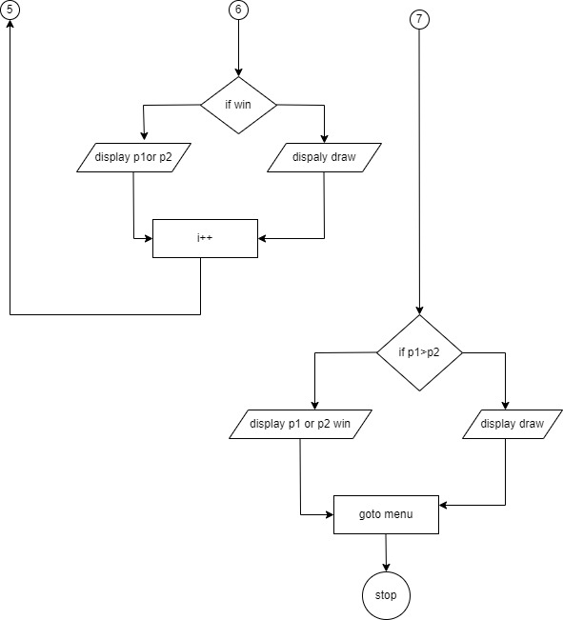

Slide 14
Gantt chart
S.N | TASK | July | August | September | October | November | December
1 | Concept submission
2 | Requirement gathering
3 | Analysis and System design
4 | Coding and development
5 | Testing and debugging
6 | Maintenance
7 | Documentation
Task completed
Task completed
Task remaining

Slide 15
Conclusion
In the end we would like to conclude that our aim to make this project was to develop a game which has extra features which would make the game much more interesting. Tic-tac-toe is most familiar game among all the age groups. An algorithm of playing Tic-tac-toe is presented and tested that works in efficient way. Some room for improvements are also there which will be corrected in the future. We would like to thank all those who have helped us and contributed in making this project.

Slide 16
Reference
Finigami. (2021, August 27). Retrieved from Wikipedia: https://en.m.wikipedia.org/wiki/Ultimate_tic-tac-toe?fbclid=IwAR3F_4YvzepF3fF8BKSXP1fbRQ3xvhEKu7dUG38k8PgXajIrU2rA3uE2eOA#cite_ref-1
Programming Knowledge (Director). (2020). C Tutorial for Beginners [Motion Picture].
Subedi, D. (2011, June 23). Code in code. Retrieved from Code in Code: http://www.codeincodeblock.com/2011/06/mini-project-tic-tac-game-source-code.html?fbclid=IwAR0MXY8qWVt_jfm_V5hqUoKsqruh-c0nu_IbF_SMV-aUbTKu9iUdXsQsUw0

Slide 17
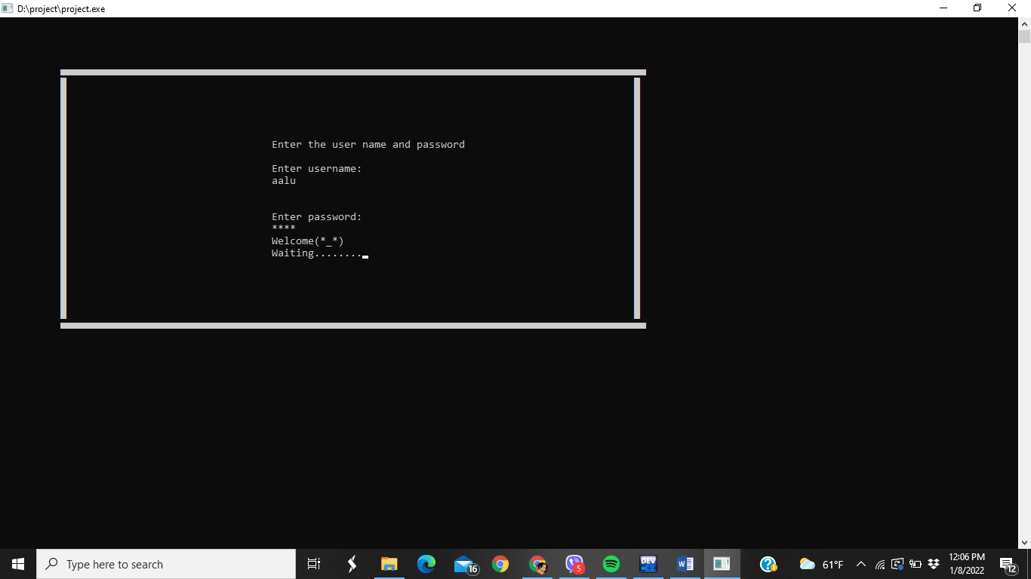
Login method

Slide 18
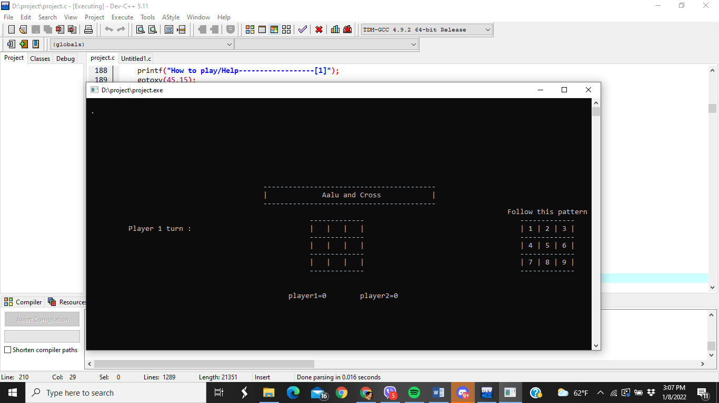
Best of three

Slide 19
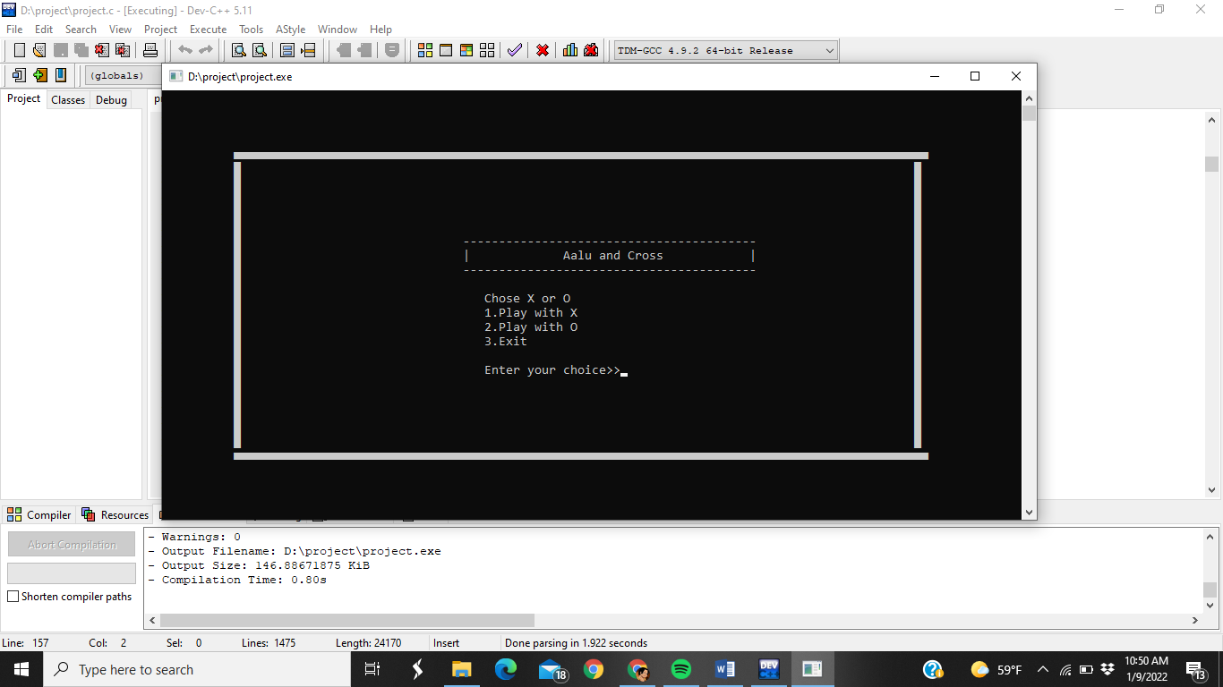
Player vs player

Slide 20
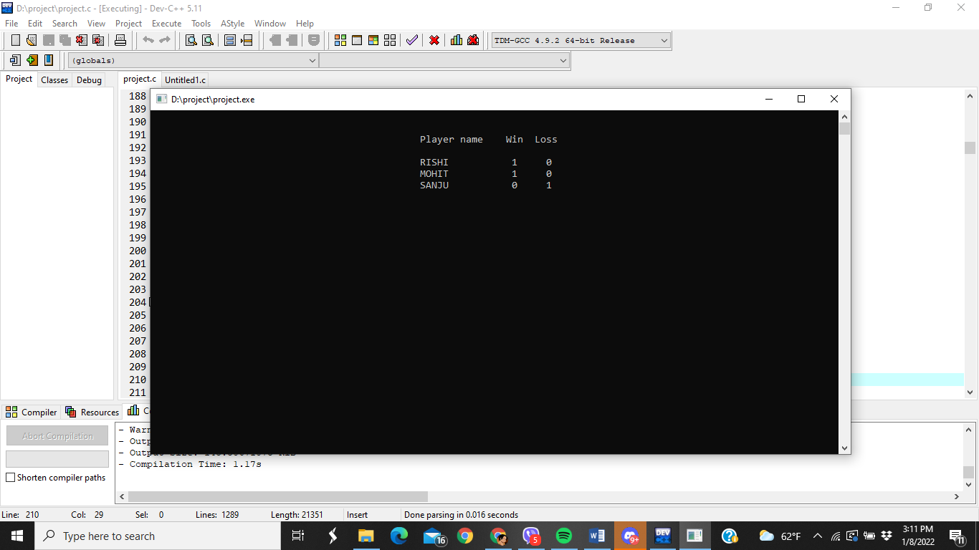
Score board

Slide 21
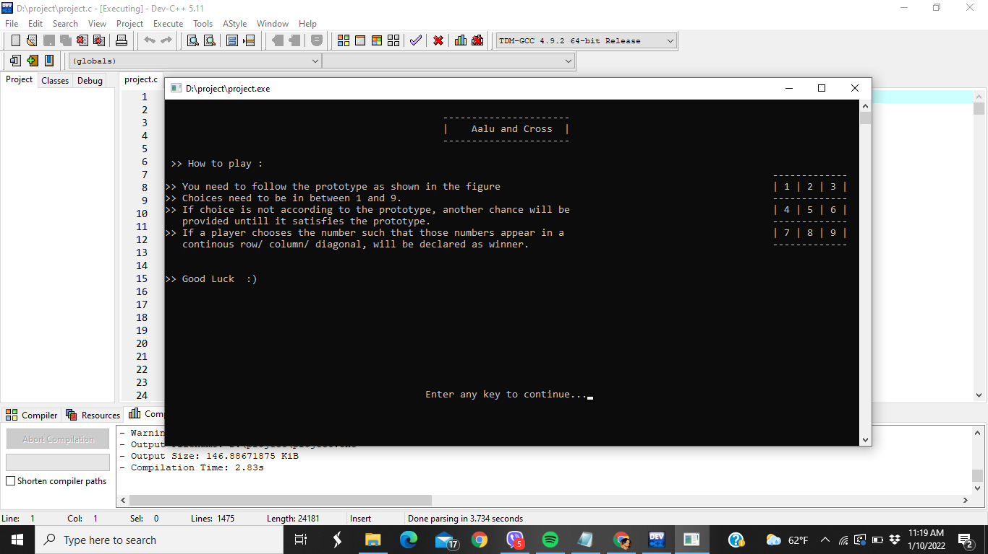
How to play

Slide 22

ANY QUESTION ????

Slide 23
THANK YOU…

